Slide 1
CSCI3170 Introduction to Database Systems
Tutorial 6 – Schema Refinement
Vito, CHEN Jiamin
2021/2022 T1

Slide 2
Outline
Motivation of Schema Refinement
Concept of Functional Dependency
Functional Dependency Reasoning

Slide 3
Motivation
Problems caused by redundancy:
Waste of resources of storage
Potential information inconsistency
– Update
– Insertion
– Deletion
Id | name | age | rating | Hourly_wages | Hours_worked
123-22-3666 | Peter | 48 | 8 | 10 | 40
231-31-5368 | Paul | 22 | 8 | 10 | 30
131-24-3650 | Mary | 35 | 5 | 7 | 30
434-26-3751 | David | 35 | 5 | 7 | 32
612-67-4134 | Ada | 35 | 8 | 10 | 40
Hourly_wages = f(rating)

Slide 4
Motivation
- How to deal with such situations?
- Decomposition? Any rules/guidance?
Id | name | age | rating | Hourly_wages | Hours_worked
123-22-3666 | Peter | 48 | 8 | 10 | 40
231-31-5368 | Paul | 22 | 8 | 10 | 30
131-24-3650 | Mary | 35 | 5 | 7 | 30
434-26-3751 | David | 35 | 5 | 7 | 32
612-67-4134 | Ada | 35 | 8 | 10 | 40
Hourly_wages = f(rating)

Slide 5
Functional Dependency
Functional dependency (FD) is a type of integrity constraints that is generalization of notation of key.
Definition
R - a relation schema, attribute set α, β ⊂ R
α → β if and only if,
For any relation instance r of R
For any two tuples t1, t2 of r
Пα(t1) = Пα(t2) ⇨ Пβ(t1) = Пβ(t2) || t1.α = t2.α ⇨ t1.β = t2.β

Slide 6
FD - Example
Check what functional dependency the following relation satisfies:
 | A | B | C | D
1 | a₁ | b₁ | c₁ | d₁
2 | a₁ | b₂ | c₁ | d₂
3 | a₂ | b₂ | c₂ | d₂
4 | a₂ | b₂ | c₂ | d₃
5 | a₃ | b₃ | c₂ | d₄

Slide 7
Is A → C a valid FD?
FD - Example
 | A | B | C | D
1 | a₁ | b₁ | c₁ | d₁
2 | a₁ | b₂ | c₁ | d₂
3 | a₂ | b₂ | c₂ | d₂
4 | a₂ | b₂ | c₂ | d₃
5 | a₃ | b₃ | c₂ | d₄
∴ A → C is a valid functional dependency!

Slide 8
Is C → A a valid FD?
FD - Example
 | A | B | C | D
1 | a₁ | b₁ | c₁ | d₁
2 | a₁ | b₂ | c₁ | d₂
3 | a₂ | b₂ | c₂ | d₂
4 | a₂ | b₂ | c₂ | d₃
5 | a₃ | b₃ | c₂ | d₄
∴ C → A is NOT a valid functional dependency!

Slide 9
FD - Example
Is D → B a valid FD?
 | A | B | C | D
1 | a₁ | b₁ | c₁ | d₁
2 | a₁ | b₂ | c₁ | d₂
3 | a₂ | b₂ | c₂ | d₂
4 | a₂ | b₂ | c₂ | d₃
5 | a₃ | b₃ | c₂ | d₄
∴ D → B is a valid functional dependency!

Slide 10
Functional Dependency
If all tuples never agree on α value, then α → β is trivially preserved.
if β ⊆ α, then α → β is called trivial dependency.

Slide 11

FD vs Key
Attribute set α is a super key for relation schema R ⇔ α → R
α is a candidate key for R ⇔
α → R
There is no $γ$ s.t. $γ$ ⊆ α, $γ$ → R (minimal)

Slide 12
FD vs Key - Example
A | B | C | D
a₁ | b₂ | c₁ | d₂
a₂ | b₂ | c₁ | d₂
a₁ | b₄ | c₃ | d₃
a₄ | b₄ | c₃ | d₄
Given:
AC → R, AD → R, ACD → R

Slide 13
FD vs Key - Example
A | B | C | D
a₁ | b₂ | c₁ | d₂
a₂ | b₂ | c₁ | d₂
a₁ | b₄ | c₃ | d₃
a₄ | b₄ | c₃ | d₄
Given:
AC → R, AD → R, ACD → R
∵AC → R
∴ AC is a super key
∵ A → R is not valid
C → R is not valid
∴ AC is a candidate key!

Slide 14
FD vs Key - Example
A | B | C | D
a₁ | b₂ | c₁ | d₂
a₂ | b₂ | c₁ | d₂
a₁ | b₄ | c₃ | d₃
a₄ | b₄ | c₃ | d₄
Given:
AC → R, AD → R, ACD → R
∵AD → R
∴ AD is a super key
∵ A → R is not valid
D → R is not valid
∴ AD is a candidate key!

Slide 15
FD vs Key - Example
Given:
AC → R, AD → R, ACD → R
A | B | C | D
a₁ | b₂ | c₁ | d₂
a₂ | b₂ | c₁ | d₂
a₁ | b₄ | c₃ | d₃
a₄ | b₄ | c₃ | d₄
∵ACD → R
∴ ACD is a super key
∵ AC → R is valid
AD → R is valid
∴ ACD is NOT a candidate key!

Slide 16
Functional Dependency Reasoning
Definition
F – a set of FDs, f – an FD
F → f means: If whenever all FDs in F are true, then f is true
E.g. F = {A → B, B → C}, F implies A → C
F⁺ – closure of F: the set of all functional dependencies that F implies
E.g. F = {A → B}
F⁺ = {A → A, B → B, AB → AB, A → B, A → AB, AB → A, AB → B}

Slide 17
FD Reasoning - Armstrong’s Axioms
Reflexivity: If β ⊆ α then α → β (trivial dependency)
Augmentation: If α → β then α 𝛾 → β 𝛾
Transitivity: If α → β, β → 𝛾 then α → 𝛾

Slide 18
Attribute closure
Computing the closure of a set of FDs can be expensive. (Size of closure is exponential)
Typically, we just want to check if a given FD α → β is in the closure of a set of FDs F.
An efficient check:
Compute attribute closure of α (denoted α⁺)
Check if β is in α⁺
(Sets of attributes functionally determined by α under F)

Slide 19
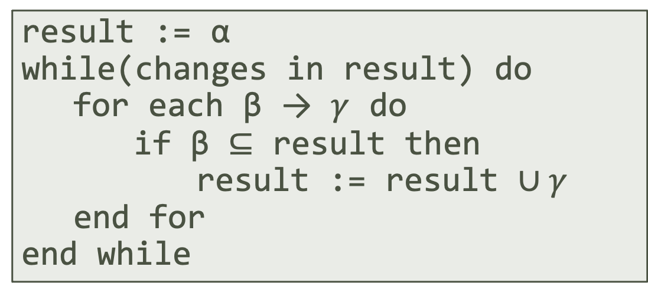
Attribute closure
α – a set of attributes
α⁺ – closure of α under F (attribute closure)
Algorithm to compute α⁺:
result := α
while(changes in result) do
for each β → $γ$ do
if β ⊆ result then
result := result ∪ $γ$
end for
end while

Slide 20
Attribute closure - Examples
R = (A, B, C, D)
F = { A → B, B → C }
To compute A⁺ :
closure = A
closure = AB (A → B)
closure = ABC (B → C)

Slide 21
Attribute closure - Examples
R = (A, B, C, D, E, F)
F = {A → C, C → D, D → B, E → F}
Find all the possible candidate key?
∵A → C, C → D, D → B
∴ A → ABCD
∵ E → F
∴ E → EF
∴ AE → ABCDEF
∴ AE is a candidate key!
Check AE⁺ :
closure = AE
closure = ACE (A → C)
closure = ACDE (C → D)
closure = ABCDE (D → B)
closure = ABCDEF (E → F)

Slide 22

Decomposition
Id | name | age | rating | Hourly_wages | Hours_worked
123-22-3666 | Peter | 48 | 8 | 10 | 40
231-31-5368 | Paul | 22 | 8 | 10 | 30
131-24-3650 | Mary | 35 | 5 | 7 | 30
434-26-3751 | David | 35 | 5 | 7 | 32
612-67-4134 | Ada | 35 | 8 | 10 | 40
$$rating→Hourly_wages$$
Id | name | age | rating | Hours_worked
123-22-3666 | Peter | 48 | 8 | 40
231-31-5368 | Paul | 22 | 8 | 30
131-24-3650 | Mary | 35 | 5 | 30
434-26-3751 | David | 35 | 5 | 32
612-67-4134 | Ada | 35 | 8 | 40
rating | Hourly_wages
8 | 10
5 | 7

Slide 23
Remarks
Decomposition: avoid redundant information by separating into a collection of ‘smaller’ relations
A FD is identified based on the set of constraints that explicitly/implicitly imposed by the application, not on individual relation instance.

